Slide 1
Electronic Conversion of the IL-TRM
Presented to the SAG on
June 24th, 2014
By: Stefano Galiasso
Shraddha Raikar

Slide 2
Agenda
Why an electronic version?
Current status
Workbooks
Example Measures
TRC calculation
Next steps

Slide 3
Why an Electronic Version
Currently the Illinois TRM is a Word document
(>1000 pgs)
Measures either have deemed savings or deemed algorithms and inputs based on various scenarios
Deemed inputs are provided in look-up tables
This format is sufficient for determining savings for individual measures
Savings of multiple measures in a program are difficult to calculate
Program Administrators expressed a need to come up with a common standardized tool/electronic version of the TRM

Slide 4
Current Status
Initial request from Nicor
Held multiple meetings last year to decide on a format
ERC presented to the TAC in November 2013 where the committee gave comments and suggestions
Incorporated SAG feedback to include references, easy navigation between measures, and TRC calculations

Slide 5
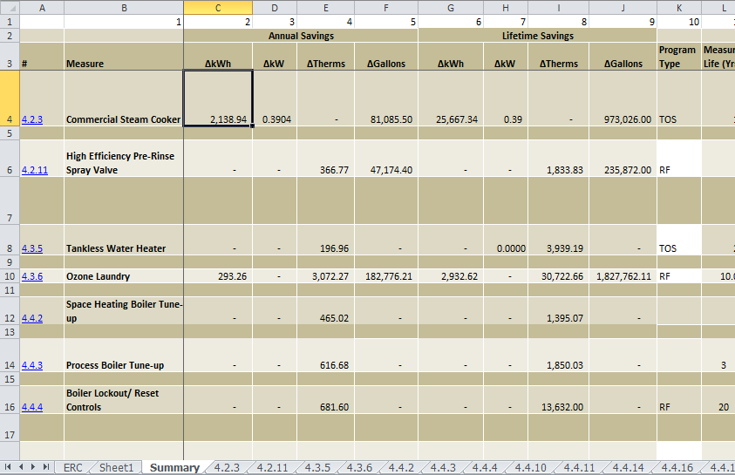
Work Book

Slide 6
Measure Example #1
4.4.17 Variable Speed Drive for HVAC
Inputs
Building Type: Office
Application Type: Chilled Water Pump
Horse Power: 10 Hp
Type: HVAC

Slide 7
Measure Example #2
4.5.4 LED Bulbs and Fixtures
Inputs:
Lamp Type: Directional
Bulb Type: Reflector with medium screw bases with diameter less or equal to 2.25”
Lumen Range: 450 – 499
Building Type: Elementary School
Electric Heating?: False
Installation Year: 2014 - 2019

Slide 8
Can we do TRCs?
The group had expressed interest in the tool to be able to do TRC calculations
Allow Program Administrators to plan their portfolio
In initial stage of development
Based on DSMore and Bencost modelling tools (currently used by utilities and DCEO)

Slide 9
Next Steps
Make edits based on feedback
Update the spreadsheets once TRM v4.0 is finalized
Allow the TRC tool to input multiple iterations of an individual measure

Slide 10
Thank You

